Slide 1

www.di-lib.com
Your Online Library

Slide 2
Our Team
171805011 - Atakan Üner 171805046 - Uygar Utku Öztürk 171805028 - Onur Andıç

Slide 3
What is Di-Lib ?
Di-Lib is a online platform you can find, read and publish books. Readers can add books to their readlists. Writers can publish their books with other users. People can make comments to the book they read.
Shortly it is a platform that makes readers’s and writers’s life much more easy.

Slide 4
Our Target Group
We want to reach everyone who can read. From 10 to 90 everyone who likes to read and share thier opinions will be welcomed here. No matter what is your age, your gender, your work. If you can read, enjoy it.

Slide 5
What You Need
If you want to visit our site, you just need 2 things:
1-) Internet Access
2-) An internet-capable device
That is all you need.

Slide 6
System Capabilities
What you can do on our system ?
1-) You can search for any book.
2-) You can search for any category.
3-) You can create your own library.
4-) You can make comments and share your opinions about the books.
5-) You can publish your own book.

Slide 7
On Going Development
We are adding some new features for you.
1-) You will be able to add someone as a friend.
2-) You will be able to create private chat rooms for 2 or more people.
3-) You will be able to upload images to your profile.
4-) You will be able to upload videos to your profile.
5-) There will be a ‘News Tab’ about new books, critics, writers etc.
6-) There will be live stream feature for digital fan meetings.

Slide 8
Highlights
We want to show you some of our user stories that changes lifes:
I am a critic of a some newspaper. I am sharing my own comments on my page. But usually I can not reach to the majority. Not everyone is reading the newspaper that I write. When I heard I can share my comments on Di-Lib I registered the system so now I can share my comments about the books on my page and with that I can reach much more people than newspapers. This is a whole new level for my job.

Slide 9
Highlights
I am a student who likes to collect different books of a different series. I can call myself a collector. But it can be a difficult thing because sometimes I can’t find the books I want or some books are not being printed anymore. This makes my hobby very unplesant. That is why I joined the Di-Lib. On the system I can find every book I want and I can build my own digital library. I can collect the books I looking for easily. Di-Lib helped me a lot.

Slide 10
Highlights
I am a amator writer. For many years I wrote many books but none of them has been published. Publishers didn’t like my books or they thought they couldn’t earn much money. This made me very upset for many years. But some time ago I heard an app that named Di-Lib. I found I can publish my books on the system online so I registered and published my books. People loved them. They posted thousands of good review to my books. With the help of Di-Lib I published my books.

Slide 11
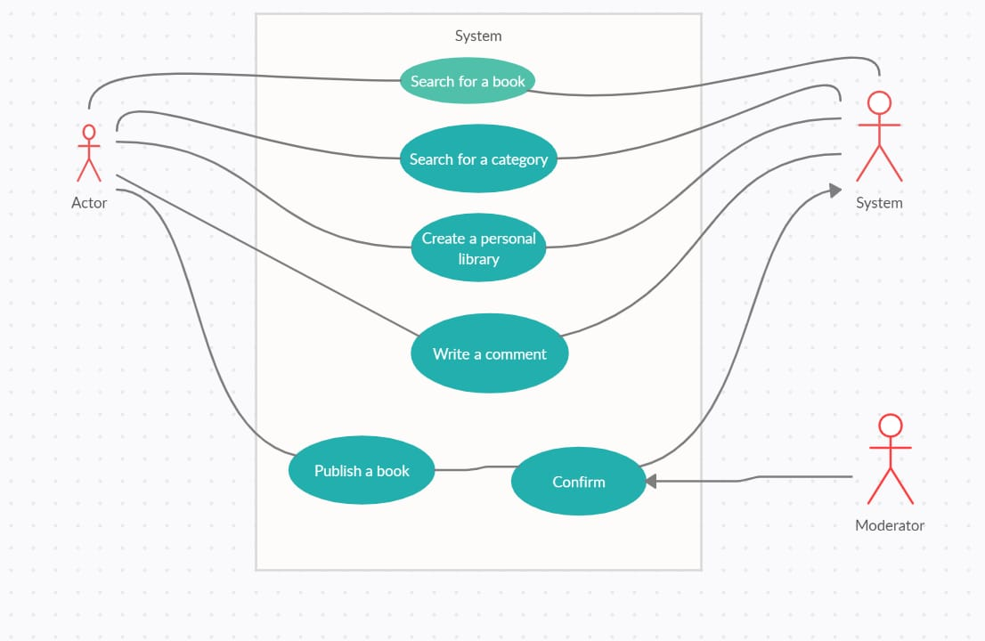
Use Case Diagram

Slide 12
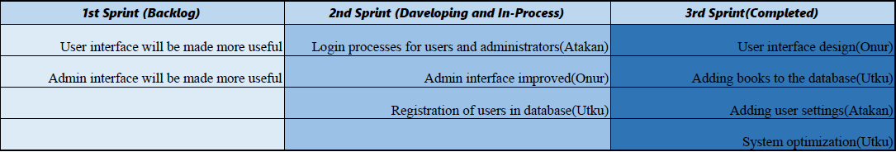
Our Sprint Plan

Slide 13
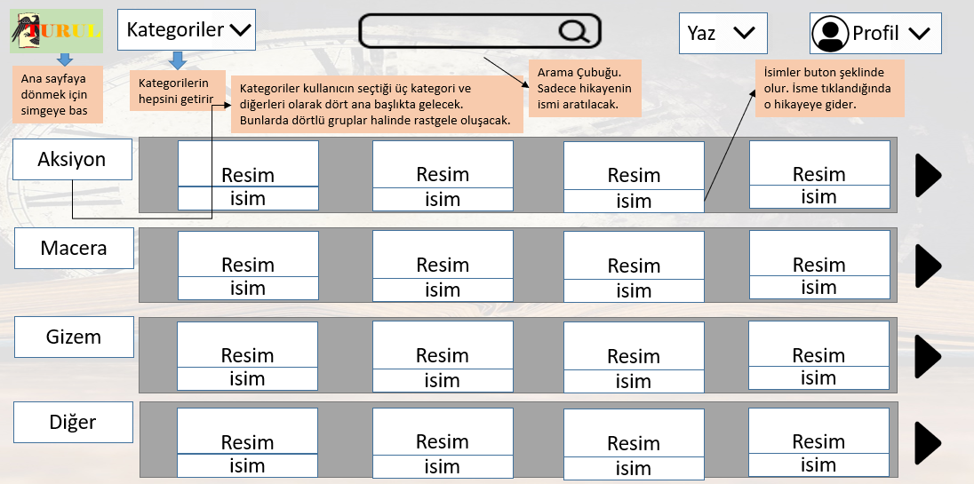

Demo of the User Interface -Main Page

Slide 14
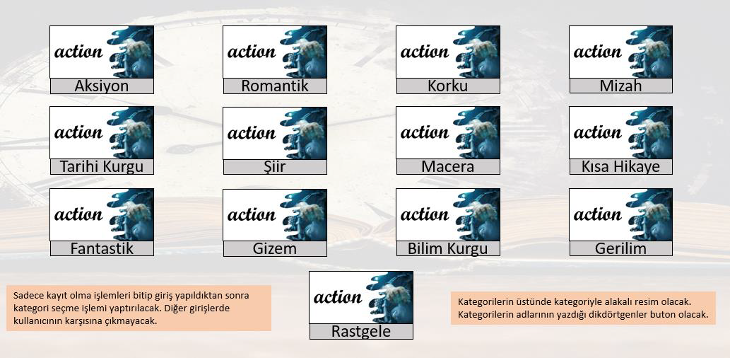
Demo of the User Interface -Categories

Slide 15
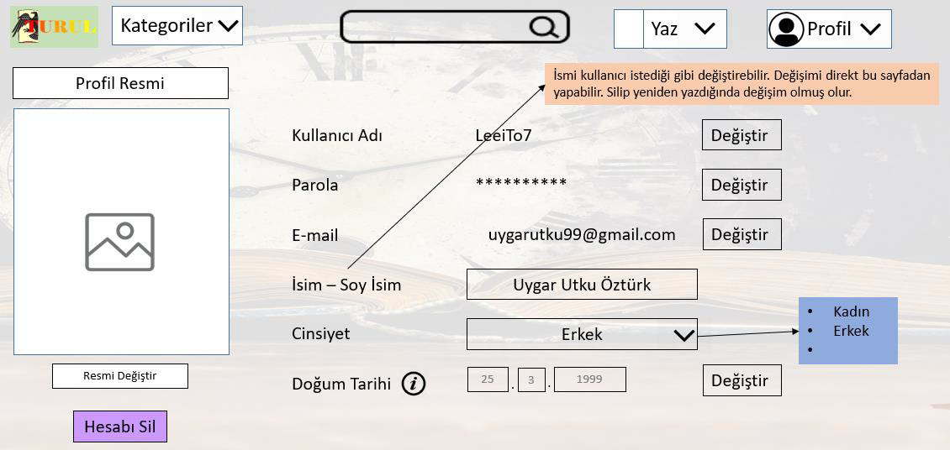

Demo of the User Interface -Profile

Slide 16
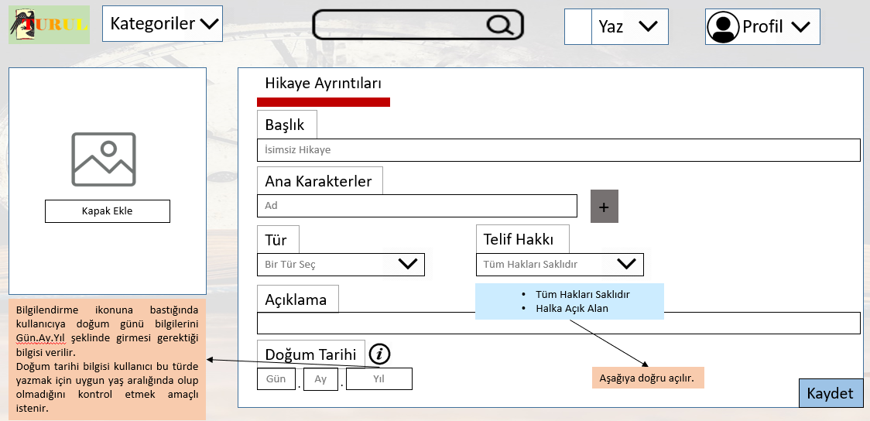

Demo of the User Interface -Adding Book

Slide 17
What We Learn
We learned customer-developer relations.
We learned how to work as a team.
We learned we need to care about users requests.
We learned the challenges of a Project.
We learned how to make a technical plan.

Slide 18
Thank You For Listening

